Slide 1
Stack MCQs

Slide 2
GATE | GATE CS 1996 | Question 12
Consider the following statements:
First-in-first out types of computations are efficiently supported by STACKS.
Implementing LISTS on linked lists is more efficient than implementing LISTS on an array for almost all the basic LIST operations.
Implementing QUEUES on a circular array is more efficient than implementing QUEUES on a linear array with two indices.
Last-in-first-out type of computations are efficiently supported by QUEUES.
Which of the following is correct?
(A) (ii) and (iii) are true (B) (i) and (ii) are true (C) (iii) and (iv) are true (D) (ii) and (iv) are true

Slide 3

Queue
Our software queues have counterparts in real world queues.
We wait in
queues to buy pizza,
to enter movie theaters,
to drive on a turnpike, and
to ride on a roller coaster.

Slide 4
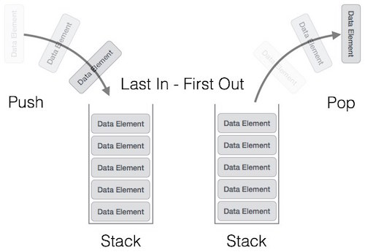
Stacks
Stack is a linear data structure which follows a particular order in which the operations are performed.
The order may be LIFO(Last In First Out) or FILO(First In Last Out).

Slide 5
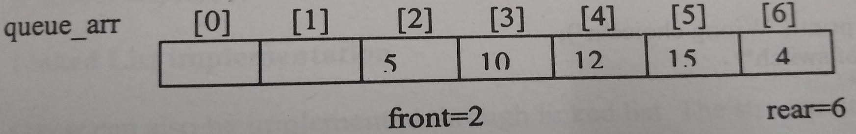
Problem-
A situation arises when
rear is at the last position of array and
front is not at the 0th position.
But we cannot add element any element in queue because rear is at the n-1th position.
There are 2 spaces for adding elements in queue but
we cannot add any element in queue because rear is at the last position of array

Slide 6
GATE | GATE CS 1996 | Question 12
Consider the following statements:
First-in-first out types of computations are efficiently supported by STACKS.
Implementing LISTS on linked lists is more efficient than implementing LISTS on an array for almost all the basic LIST operations.
Implementing QUEUES on a circular array is more efficient than implementing QUEUES on a linear array with two indices.
Last-in-first-out type of computations are efficiently supported by QUEUES. Which of the following is correct?
(A) (ii) and (iii) are true (B) (i) and (ii) are true (C) (iii) and (iv) are true (D) (ii) and (iv) are true Answer: (A) Explanation: i -STACK is the data structure that follows Last In First Out (LIFO) or First In Last Out (FILO) order, in which the element which is inserted at last is removed out first.
ii – Implementing LISTS on linked lists is more efficient than implementing it on an array for almost all the basic LIST operations because the insertion and deletion of elements can be done in O(1) in Linked List but it takes O(N) time in Arrays.
iii- Implementing QUEUES on a circular array is more efficient than implementing it on a linear array with two indices because using circular arrays, it takes less space and can reuse it again.
iv – QUEUE is the data structure that follows First In First Out (FIFO) or Last In Last Out (LILO) order, in which the element which is inserted first is removed first.
only (ii) and (iii) are TRUE. Option (A) is correct.

Slide 7
GATE | GATE-CS-2002 | Question 44
To evaluate an expression without any embedded function calls: (A) One stack is enough (B) Two stacks are needed (C) As many stacks as the height of the expression tree are needed (D) A Turing machine is needed in the general case

Slide 8
GATE | GATE-CS-2002 | Question 44
To evaluate an expression without any embedded function calls: (A) One stack is enough (B) Two stacks are needed (C) As many stacks as the height of the expression tree are needed (D) A Turing machine is needed in the general case Answer: (A) Explanation: Any expression can be converted into Postfix or Prefix form. Prefix and postfix evaluation can be done using a single stack.

Slide 9
Data Structures | Stack | Question 8 (GATE CS 2004)
A single array A[1..MAXSIZE] is used to implement two stacks. The two stacks grow from opposite ends of the array. Variables top1 and top2 (topl< top 2) point to the location of the topmost element in each of the stacks. If the space is to be used efficiently, the condition for “stack full” is
(A) (top1 = MAXSIZE/2) and (top2 = MAXSIZE/2+1) (B) top1 + top2 = MAXSIZE (C) (top1= MAXSIZE/2) or (top2 = MAXSIZE) (D) top1= top2 -1

Slide 10
Data Structures | Stack | Question 8 (GATE CS 2004)
(A) (top1 = MAXSIZE/2) and (top2 = MAXSIZE/2+1) (B) top1 + top2 = MAXSIZE (C) (top1= MAXSIZE/2) or (top2 = MAXSIZE) (D) top1= top2 -1
Option c)
top1+top2=MAXSIZE
Here Stack is full, top1=4, top2=5, top1+top2=9 Not Equal to MAXSIZE, thus FALSE
Option d)
top1=top2-1, TRUE in every case
1 | 2 | 3 | 4 | 5 | 6 | MAXSIZE=7
top1 |  |  |  |  |  | top2
1 | 2 | 3 | 4 | 5 | 6 | MAXSIZE=7
 |  |  | top1 | top2

Slide 11
Data Structures | Stack | Question 8 (GATE CS 2004)
(A) (top1 = MAXSIZE/2) and (top2 = MAXSIZE/2+1) (B) top1 + top2 = MAXSIZE (C) (top1= MAXSIZE/2) or (top2 = MAXSIZE) (D) top1= top2 -1
Option a)
If more elements were inserted in Stack1 and less elements were inserted in Stack2
top1=MAXSIZE/2=8/2=4
top2=MAXSIZE/2+1=8/2+1 =5
But here top1 and top2 will have constant values, FALSE
For Option c)
top1=MAXSIZE/2=8/2=4
top2=MAXSIZE=8, FALSE
1 | 2 | 3 | 4 | 5 | 6 | 7 | MAXSIZE=8
top1 |  |  |  |  |  |  | top2
1 | 2 | 3 | 4 | 5 | 6 | 7 | MAXSIZE=8
 |  |  |  |  | top1 | top2

Slide 12
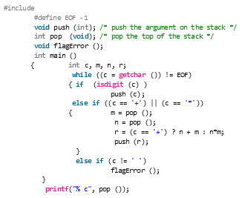
GATE | Gate IT 2007 | Question 32
Consider the following C program:
What is the output of the program for the following input ? 5 2 * 3 3 2 + * + (A) 15 (B) 25 (C) 30 (D) 150

Slide 13
GATE | Gate IT 2007 | Question 32
Consider the following C program:
What is the output of the program for the following input ? 5 2 * 3 3 2 + * + (A) 15 (B) 25 (C) 30 (D) 150 Answer: (B)
Explanation:
The function of the program is:-
1) If the current character is a digit it pushes into stack 2) Else if the current character is operator, it pops two elements and then performs the operation. Finally it pushes the resultant element into stack. Initially stack s is empty. 5 2 * 3 3 2 + * + 1) 5 -> It pushes into s 2) 2 -> It pushes into s 3) * -> It pops two elements n = 2, m=5 n*m = 10 It pushes 10 into s 4) 3 -> It pushes into s 5) 3 -> It pushes into s 6) 2 -> It pushes into s 7) + -> n=2, m=3 n+m=5 It pushes 5 into s 8) * -> n=5, m=3 n*m=15 It pushes 15 into s 9) + -> n=15, m=10 n+m = 25 It pushes 25 into s.
Finally the result value is the only element present in stack.

Slide 14
GATE | Gate IT 2007 | Question 32
Explanation:
The function of the program is:-
If the current character is a digit it pushes into stack
Else if the current character is operator + or *, it pops two elements and then performs the operation. Finally it pushes the resultant element into stack.

Slide 15
Explanation:
Initially stack s is empty.
Scan 5 2 * 3 3 2 + * +
1) 5 -> Push 2) 2 -> Push 3) * -> It pops two elements m = 2, n=5
n*m =5*2= 10 ,
Push 10
4) 3 -> Push 5) 3 -> Push 6) 2 -> Push 7) + -> Pop m=2, Pop n=3, n+m=3+2=5, Push 5 into s 8) * -> m=5, n=3 n*m=5*3=15 Push 15 into s 9) + -> m=15, n=10 n+m =10+15=25 Push 25
Finally the result value is the only element present in stack.
GATE | Gate IT 2007 | Question 32
2
5
10
2
3
3
10
5
3
10
15
10
25

Slide 16
GATE | GATE-CS-2015 (Set 3) | Question 65
The result evaluating the postfix expression (10) 5 + (60) 6 / * 8 – is
(A) 284 (B) 213 (C) 142 (D) 71

Slide 17
GATE | GATE-CS-2015 (Set 3) | Question 65
The result evaluating the postfix expression 10 5 + 60 6 / * 8 – is (A) 284 (B) 213 (C) 142 (D) 71 Answer: (C)
Push 10,5
On Scanning +, 10 + 5=15, Push 15, 60, 6
On Scanning /, 60/6=10, Push 10
On Scanning *, 15*10=150, Push 150, 8
On Scanning -, 150-8=142 (Ans)
Stack
5
10
Stack
15
Stack
6
60
15
Stack
10
15
Stack
150
Stack
8
150

Slide 18
ISRO | ISRO CS 2017 – May | Question 57
The best data structure to check whether an arithmetic expression has balanced parenthesis is a (A) Queue (B) Stack (C) Tree (D) List

Slide 19
ISRO | ISRO CS 2017 – May | Question 57
The best data structure to check whether an arithmetic expression has balanced parenthesis is a (A) Queue (B) Stack (C) Tree (D) List Answer: (B) Explanation: Stacks can check equal pair/ balanced pair of parenthesis efficiently. Whenever we get an opening parenthesis we can push it on the stack and when we get the corresponding closing parenthesis, we can pop it. After performing all push and pop operations, if at the end of the expression stack becomes empty then the expression has a balanced parenthesis.

Slide 20
ISRO | ISRO CS 2014 | Question 43
The five items: A, B, C, D, and E are pushed in a stack, one after other starting from A. The stack is popped four items and each element is inserted in a queue. The two elements are deleted from the queue and pushed back on the stack. Now one item is popped from the stack. The popped item is (A) A (B) B (C) C (D) D

Slide 21
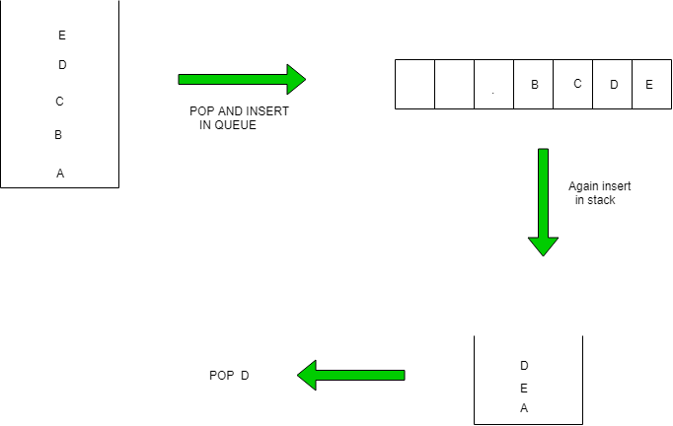
ISRO | ISRO CS 2014 | Question 43
The five items: A, B, C, D, and E are pushed in a stack, one after other starting from A. The stack is popped four items and each element is inserted in a queue. The two elements are deleted from the queue and pushed back on the stack. Now one item is popped from the stack. The popped item is (A) A (B) B (C) C (D) D Answer: (D)

Slide 22
ISRO | ISRO CS 2015 | Question 11
If the sequence of operations – push (1), push (2), pop, push (1), push (2), pop, pop, pop, push (2), pop are performed on a stack, the sequence of popped out values (A) 2,2,1,1,2 (B) 2,2,1,2,2 (C) 2,1,2,2,1 (D) 2,1,2,2,2

Slide 23
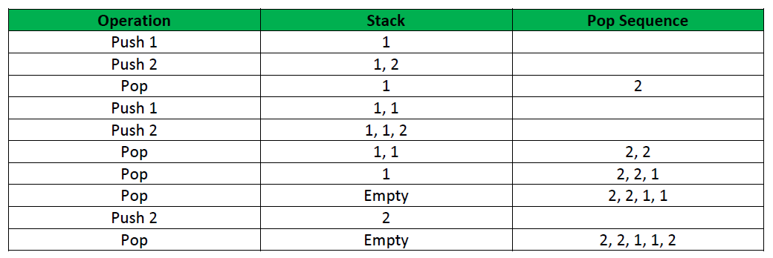
ISRO | ISRO CS 2015 | Question 11
If the sequence of operations – push (1), push (2), pop, push (1), push (2), pop, pop, pop, push (2), pop are performed on a stack, the sequence of popped out values (A) 2,2,1,1,2 (B) 2,2,1,2,2 (C) 2,1,2,2,1 (D) 2,1,2,2,2 Answer: (A) Explanation: The pop sequence can be seen from the following table:

Slide 24
GATE 1994
Which of the following permutation can be obtained in the output( in the same order) using a stack assuming that input is the sequence 1,2,3,4,5 in that order? (A) 3,4,5,1,2
(B) 3,4,5,2,1
(C) 1,5,2,3,4
(D) 5,4,3,1,2

Slide 25
GATE 1994
Which of the following permutation can be obtained in the output( in the same order) using a stack assuming that input is the sequence 1,2,3,4,5 in that order? (A) 3,4,5,1,2
(B) 3,4,5,2,1
(C) 1,5,2,3,4
(D) 5,4,3,1,2 Ans B)

Slide 26
ISRO | ISRO CS 2017 | Question 47
Which of the following permutation can be obtained in the same order using a stack assuming that input is the sequence 5, 6, 7, 8, 9 in that order? (A) 7, 8, 9, 5, 6 (B) 5, 9, 6, 7, 8 (C) 7, 8, 9, 6, 5 (D) 9, 8, 7, 5, 6

Slide 27
ISRO | ISRO CS 2017 | Question 47
Which of the following permutation can be obtained in the same order using a stack assuming that input is the sequence 5, 6, 7, 8, 9 in that order? (A) 7, 8, 9, 5, 6 (B) 5, 9, 6, 7, 8 (C) 7, 8, 9, 6, 5 (D) 9, 8, 7, 5, 6 Explanation:
Lets try operations as-
Push 5 Push 6 Push 7 Push 8 Push 9 Pop All
The sequence will be 9,8,7,6,5
Option D is FALSE, 5 cannot be popped before 6
Explanation:
Option B is FALSE,
9 cannot be popped before 6
PUSH 5,6
POP both
Sequence=6,5
PUSH 7 etc

Slide 28
ISRO | ISRO CS 2017 | Question 47
(A) 7, 8, 9, 5, 6 (B) 5, 9, 6, 7, 8 (C) 7, 8, 9, 6, 5 (D) 9, 8, 7, 5, 6 Answer: (C) Explanation: The sequence given in option (C) is one of the only possible sequence which can be obtained. We can obtain the sequence by performing operations in the manner: Push 5 Push 6 Push 7 Pop 7 Push 8 Pop 8 Push 9 Pop 9 Pop 6 Pop 5. hence the sequence will be 7,8,9,6,5.
ISRO | ISRO CS 2017 | Question 47
(A) 7, 8, 9, 5, 6 (B) 5, 9, 6, 7, 8 (C) 7, 8, 9, 6, 5 (D) 9, 8, 7, 5, 6 Answer: (C) Explanation:
5 cannot be popped before 6
Option A) is FALSE

Slide 29
ISRO | ISRO CS 2008 | Question 67
Stack A has the entries a, b, c (with a on top). Stack B is empty. An entry popped out of stack A can be printed immediately or pushed to stack B.
An entry popped out of the stack B can be only be printed.
In this arrangement, which of the following permutations of a, b, c are not possible?
(A) b a c
(B) b c a
(C) c a b
(D) a b c

Slide 30
Explanation:
Option (A):
Pop a from stack A
Push a to stack B
Print b from Stack A
Print a from stack B
Print c from stack A
Order = b a c
Option (B):
Pop a from stack A& Push to stack B
Print b from stack A
Print c from stack A
Print a from stack A
Order = b c a
Option (C):
Pop a from stack A & Push to stack B
Pop b from stack A & Push to stack B
Print c from stack A
Now, printing a will not be possible.
ISRO | ISRO CS 2008 | Question 67
Stack A has the entries a, b, c (with a on top). Stack B is empty. An entry popped out of stack A can be printed immediately or pushed to stack B. An entry popped out of the stack B can be only be printed. In this arrangement, which of the following permutations of a, b, c are not possible?
(A) b a c
(B) b c a
(C) c a b
(D) a b c
Answer: (C)
Option d)
Pop three times from Stack A and print
Sequence=a b c
Possible

Slide 31
GATE | Gate IT 2005 | Question 13
A function f defined on stacks of integers satisfies the following properties. f(∅) = 0 and f (push (S, i)) = max (f(S), 0) + i for all stacks S and integers i.
If a stack S contains the integers 2, -3, 2, -1, 2 in order from bottom to top, what is f(S)? (A) 6 (B) 4 (C) 3 (D) 2

Slide 32
i: Element to be pushed
Initial State f(∅)=0.
For Empty Stack f(S) is 0
Then we push each element (i)one by one and calculate f(s) for each insertion as given
fnew(S)=max(fprevious(S),0)+i, the function to compute f(S) for each insertion
INSERT 2 on to Stack fprevious(S)=0 [Stack was empty ] i=2 (inserting element is i ) fnew(S)=max(fprevious(S),0)+i fnew(S)=max(0,0)+2=2
INSERT −3 on to Stack fprevious(S)=2
i=−3 (inserting element is i ) fnew(S)=max(fprevious(S),0)+i fnew(S)=max(2,0)+−3=−1

Slide 33
GATE | Gate IT 2005 | Question 13
A function f defined on stacks of integers satisfies the following properties.
f(∅) = 0
f (push (S, i)) = max (f(S), 0) + i for all stacks S and integers i.
If a stack S contains the integers 2, -3, 2, -1, 2 in order from bottom to top, what is f(S)?
Answer: (C) Explanation: f(S) = 0, max(f(S), 0) = 0, i = 2 f(S)_{new} = max(f(S), 0) + i = 0 + 2 = 2 f(S) = 2, max(f(S), 0) = 2, i = -3 f(S)_{new} = max(f(S), 0) + i = 2 – 3 = -1 f(S) = -1, max(f(S), 0) = 0, i = 2 f(S)_{new} = max(f(S), 0) + i = 0 + 2 = 2 f(S) = 2, max(f(S), 0) = 2, i = -1 f(S)_{new} = max(f(S), 0) + i = 2 – 1 = 1 f(S) = 1, max(f(S), 0) = 1, i = 2 f(S)_{new} = max(f(S), 0) + i = 1 + 2 = 3 Thus, option (C) is correct.

Slide 34
GATE | GATE MOCK 2017 | Question 19
Suppose a stack is to be implemented with a linked list instead of an array. What would be the effect on the time complexity of the push and pop operations of the stack implemented using linked list (Assuming stack is implemented efficiently)?
(A) O(1) for insertion and O(n) for deletion (B) O(1) for insertion and O(1) for deletion
(C) O(n) for insertion and O(1) for deletion
(D) O(n) for insertion and O(n) for deletion

Slide 35
GATE | GATE MOCK 2017 | Question 19
Suppose a stack is to be implemented with a linked list instead of an array. What would be the effect on the time complexity of the push and pop operations of the stack implemented using linked list (Assuming stack is implemented efficiently)?
(A) O(1) for insertion and O(n) for deletion (B) O(1) for insertion and O(1) for deletion
(C) O(n) for insertion and O(1) for deletion
(D) O(n) for insertion and O(n) for deletion
Answer: (B) Explanation: Stack can be implemented using link list having O(1) bounds for both insertion as well as deletion by inserting and deleting the element from the beginning of the list.

Slide 36
The END!!

